Slide 1
COS20019 - Cloud Computing Architecture
Assignment 3
Photoalbum Serverless/Event-driven Architectural Design
Authors:
Nguyen Ngo Thanh Long
Tran Thanh Minh

Slide 2
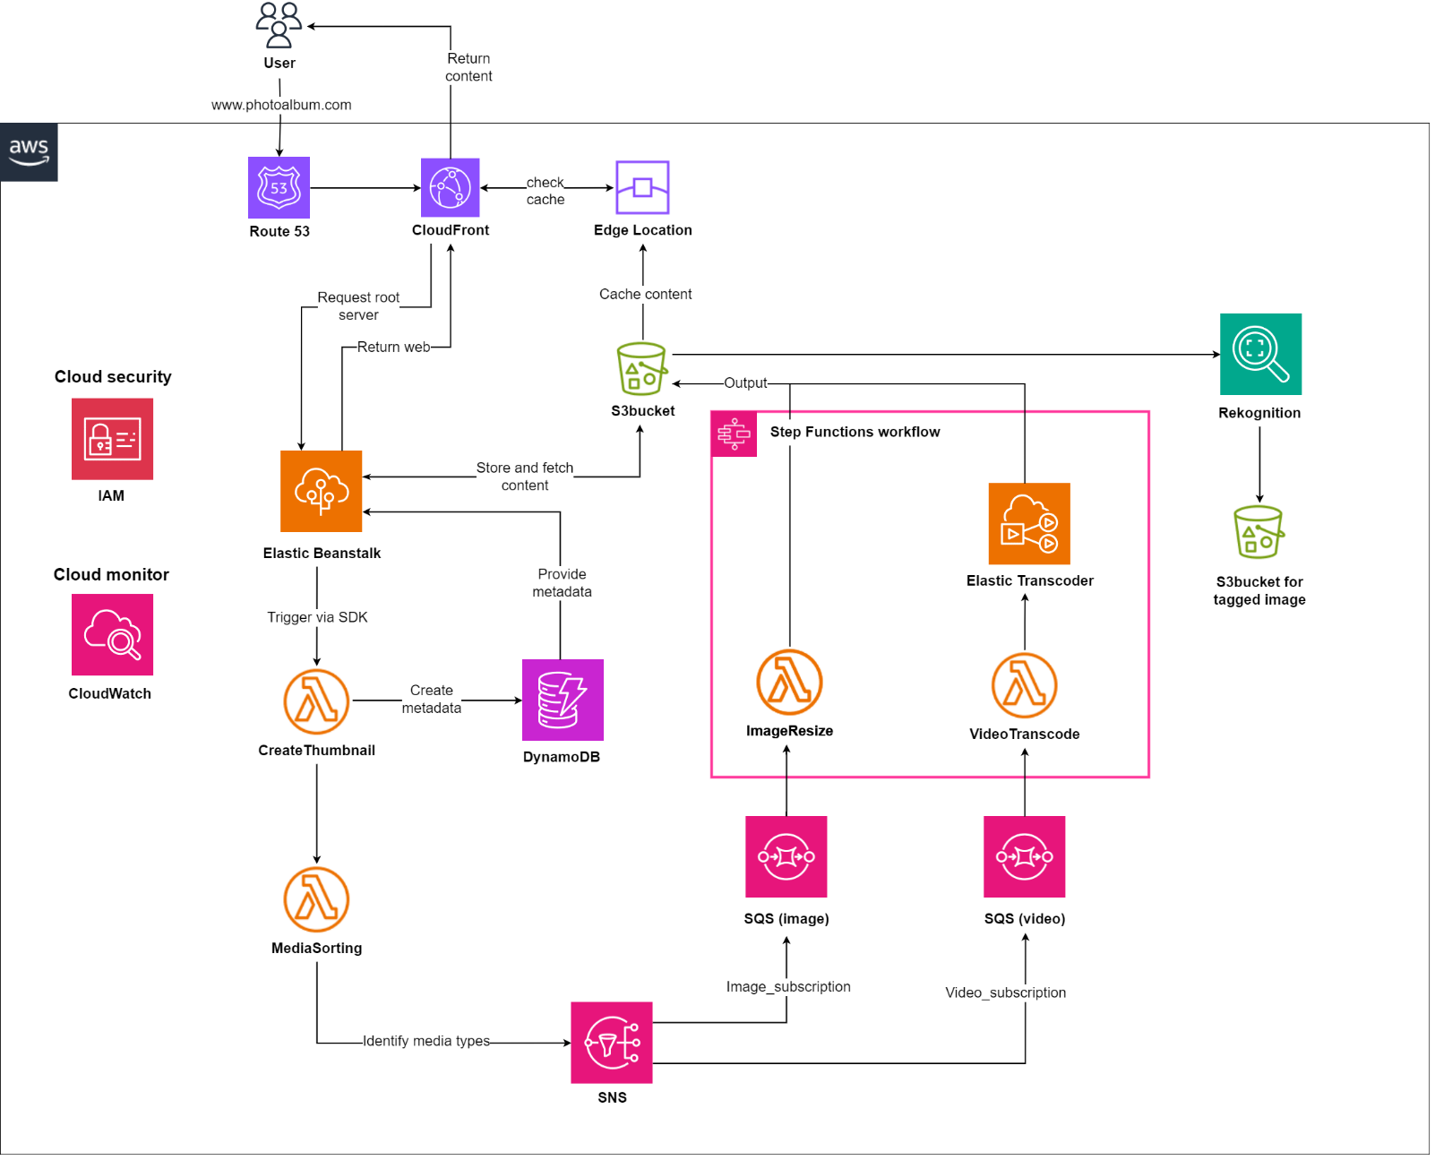
Architectural design
Three-tier architecture
+ Presentation tier
+ Application tier
+ Data tier

Slide 3
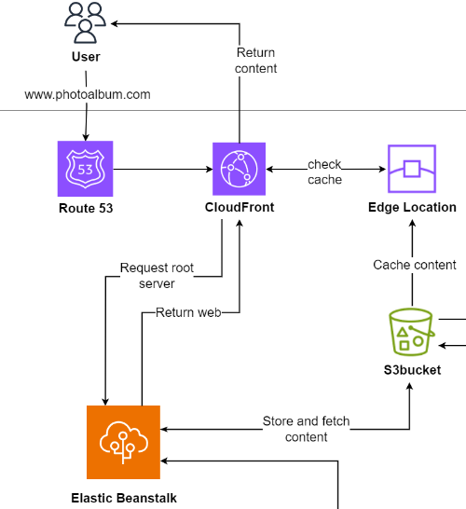
Presentation tier
Route53 for DNS resolution
CloudFront and Edge Location for low-latency content delivery
Elastic Beanstalk to host web application

Slide 4
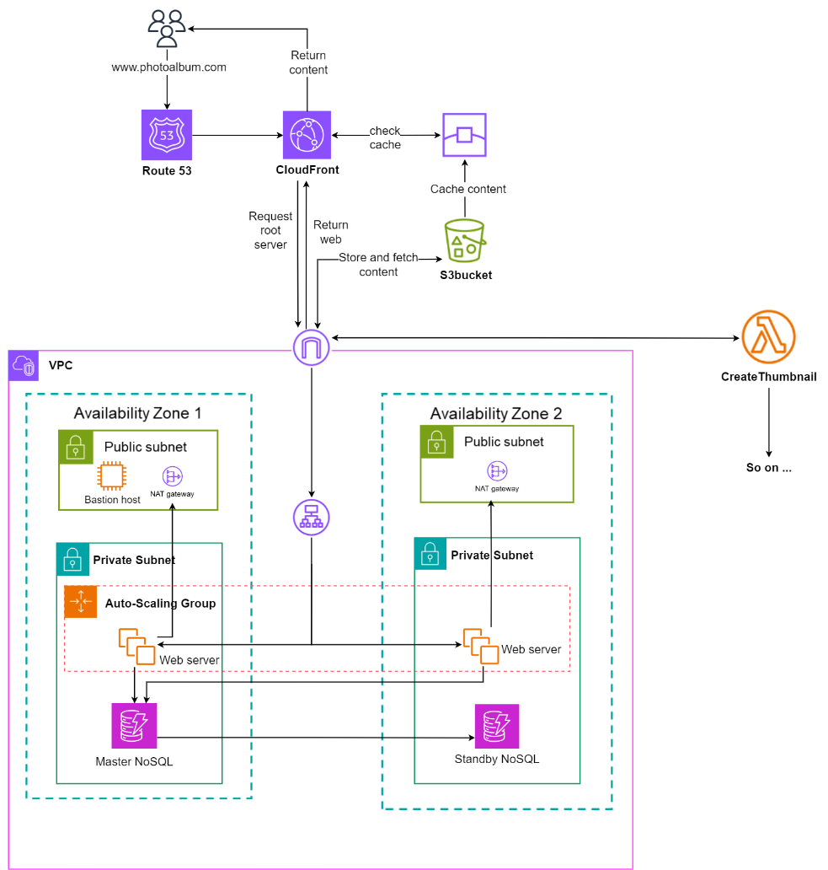
Presentation tier
Alternative design
Manually configured network for web app hosting
Pros: allow deeper control in the system
Cons: require plenty of overhead and management => lots of workload and error-prone
=> Elastic Beanstalk is suitable for the less-complex photoalbum web app

Slide 5
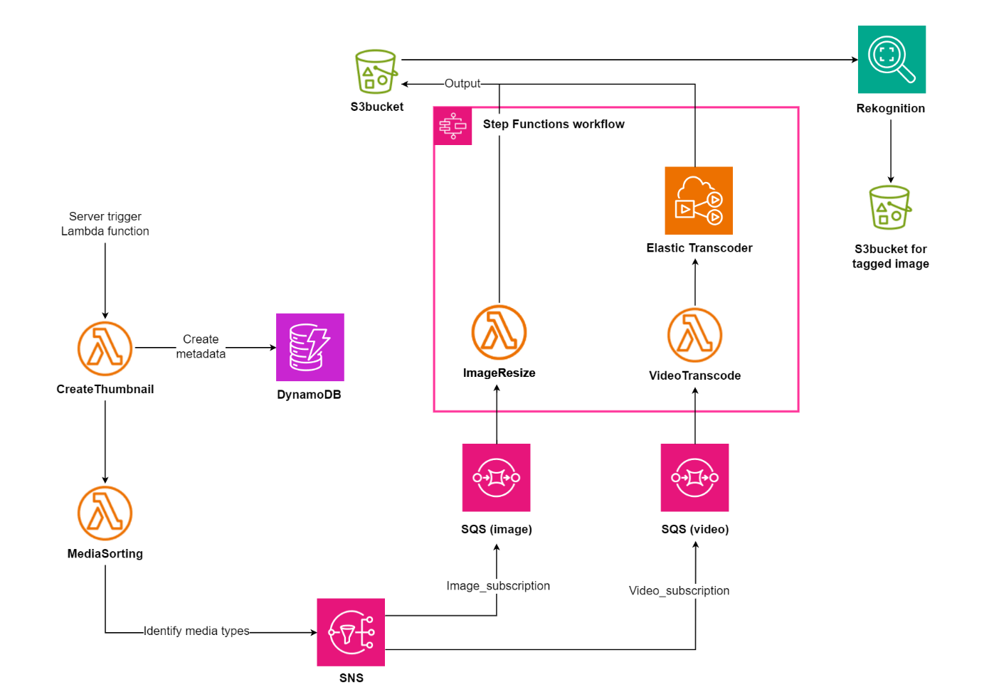
Application tier
Lambda function for serverless solution
SNS and SQS to decoupled, event-driven and message-driven workflow
Elastic Transcoder to reformat video files
Steps Function to simplify workflow construction and allow extensibility
Rekognition to identify tags in photos

Slide 6
Application tier
Fanout architecture
A SNS topic receives events from MediaSorting function
2 subscriptions filter messages by media type and send them to SQS queue
Media-processing lambda functions poll message

Slide 7
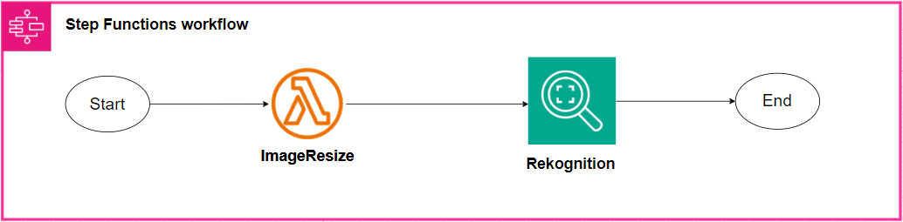
Application tier
Alternative design
Rekognition can be integrated into image-processing workflow
Only suitable if tag-identifying function is official and indispensable
=> It is built in a separate workflow for now

Slide 8
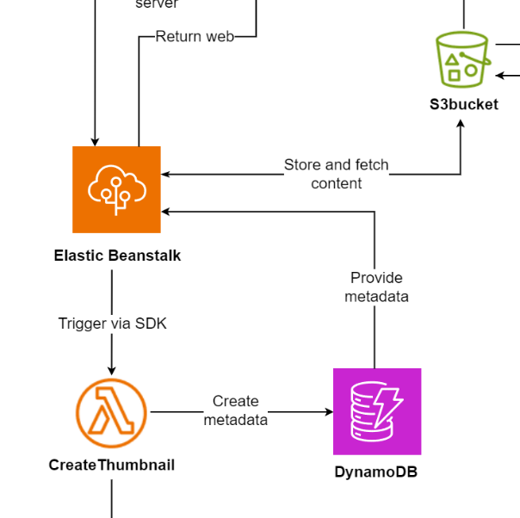
Data tier
S3 bucket for media file storage
DynamoDB for metadata records

Slide 9
Criteria Fulfillment
Category | Criteria | Solution
Security | Authentication Authorization | AWS IAM AWS CloudWatch AWS S3
Reliability | Highly available Adapt to changes in demand Recover from failures Backing up data frequently | AWS S3 AWS CloudFront AWS Elastic Beanstalk AWS DynamoDB AWS CloudWatch
Performance | Quick processing time Low latency in fatigue | AWS CloudFront AWS Route 53 AWS CloudWatch AWS Elastic Transcoder
Scalability | Handle large amounts of traffic Handle large amount of storage Scalable to adapt to demand | AWS CloudFront AWS Route 53 AWS SNS and SQS AWS Lambda DynamoDB, Elastic Beanstalk

Slide 10
Assumptions For Costs
Each Lambda function is associated with 4 custom metrics
Each media size is about 200KB.
1,000,000 queries request each month
Video are in 720 quality and the length is equal to modern MV (5 mins)
1,000,000 images are processed for AI
AI is trained for 2.5 hours
1 TB media upload

Slide 11
Costs
Service | Cost ($)
Route 53 | 2.6
CloudFront | 26.2
Elastic Beanstalk | 66.4
S3 | 28.95
SQS & SNS | 90
Elastic Transcoder | 12.5
CloudWatch | 4.8
Lambda | 9.984
Rekognition | 113.5
DynamoDB | 1659.04
Total Cost: $2013.964

